Slide 1
Reward Function Design for
Reinforcement Learning-Based
Rocket Landing
Ayo-Oluwa Sodipe
Georgia State University | CSC 4810 — Artificial Intelligence
Progress Presentation | April 2026
asodipe1@student.gsu.edu
CSC 4810 — Artificial Intelligence | Georgia State University

Slide 2
Motivation
Why does reward function design matter for rocket landing?
🚀 Real-World Stakes
🤖 RL as a Solution
❓ The Open Question
SpaceX, Blue Origin, and RocketLab depend on reliable autonomous landing. Failure is catastrophic and costly — no room for trial and error.
Reinforcement learning can discover control policies without explicit models, but only if the reward provides a usable learning signal.
How much can a simple reward function achieve? Most prior work relies on multi-stage rewards, imitation learning, or expert trajectories.
Core Research Question: Can a PPO agent learn stable rocket landing using only simple, dense reward signals — without multi-stage rewards, imitation learning, or guidance policies?
~97%
0%
100K
20
Prior work success rate (Su et al.)
Simple reward baseline (this work)
PPO training timesteps
Evaluation episodes / model
Ayo-Oluwa Sodipe | CSC 4810 — AI | Georgia State University | April 2026

Slide 3
Related Work & Research Gap
What has prior work done — and what remains unanswered?
Prior Work
Research Gap
[1] Su et al. (2022)
Prior work requires complex reward engineering (20+ components)
Imitation learning needs expert trajectory data
Multi-stage curricula add implementation overhead
Limits of simple dense rewards remain untested
No benchmark for minimal-reward PPO baselines
Multi-stage reward + imitation learning → 3-DOF pinpoint landing with PPO; fuel-optimal trajectories.
[2] Jiang et al. (2024)
Random Annealing Jump Start (RAJS) overcomes sparse rewards; 8% → 97% success on high-fidelity model.
[3] Souza et al. (2022)
Shows PPO achieves stable convergence in continuous control tasks where DDPG struggles
→ This project: isolate simple reward design as an independent variable to measure its ceiling effect on PPO performance
Ayo-Oluwa Sodipe | CSC 4810 — AI | Georgia State University | April 2026

Slide 4
Environment & Simulation Setup
Custom Gymnasium environment for 2D vertical rocket landing
State Space
Physics
Environment Diagram
y ∈ [50,100]
[x, y, vx, vy]
Horizontal pos, vertical pos,
horizontal vel, vertical vel
Gravity: −9.8 m/s²
Episode ends on ground contact
No drag or wind modeled
Action Space
Initial Conditions
Continuous thrust ∈ [0, 1]
Single thruster (vertical)
No attitude control
x₀ ∈ [−10, 10] (uniform)
y₀ ∈ [50, 100] (uniform)
Zero initial velocity
✕
(0,0)
x ∈ [−10, 10]
Intentionally simplified vs. prior work — no attitude, drag, or mass variation — to isolate reward design as the sole variable.
Ayo-Oluwa Sodipe | CSC 4810 — AI | Georgia State University | April 2026

Slide 5
Model Architecture
PPO agent trained via Stable-Baselines3 with MLP policy
Algorithm
Proximal Policy Optimization (PPO)
PPO Training Loop
Library
Stable-Baselines3
Environment
[x, y, vx, vy]
Policy
Multi-Layer Perceptron (MLP)
PPO Agent
MLP Policy
Input (State)
[x, y, vx, vy] — 4-dimensional
Output (Action)
Continuous thrust ∈ [0, 1]
Reward
Computation
Training Budget
100,000 timesteps
Evaluation
20 episodes per model variant
Policy Update
(Clipped Objective)
PPO chosen for: stable on-policy updates, no need for replay buffer, handles continuous action spaces efficiently.
Ayo-Oluwa Sodipe | CSC 4810 — AI | Georgia State University | April 2026

Slide 6
Reward Function Design
Core contribution — three progressively richer reward formulations
V1
Distance penalty only
V2
+ Vertical velocity penalty
V3
+ Horizontal position & velocity
reward = −distance
reward = −distance − 0.5|vy|
reward = −dist − 0.5|vy|
− 0.3|x| − 0.2|vx|
Baseline: penalize Euclidean distance from landing pad at every step. Pure position signal; no velocity awareness.
Add vertical velocity penalty. Agent should learn to reduce descent speed approaching ground; smoother landing trajectory.
Full signal: add horizontal position and velocity penalties. Agent should converge both position axes and maintain low lateral speed.
V1 +
V1 + V2 +
Design philosophy: each version adds one signal — enabling ablation-style analysis of which penalty terms drive (or fail to drive) convergence.
Ayo-Oluwa Sodipe | CSC 4810 — AI | Georgia State University | April 2026

Slide 7
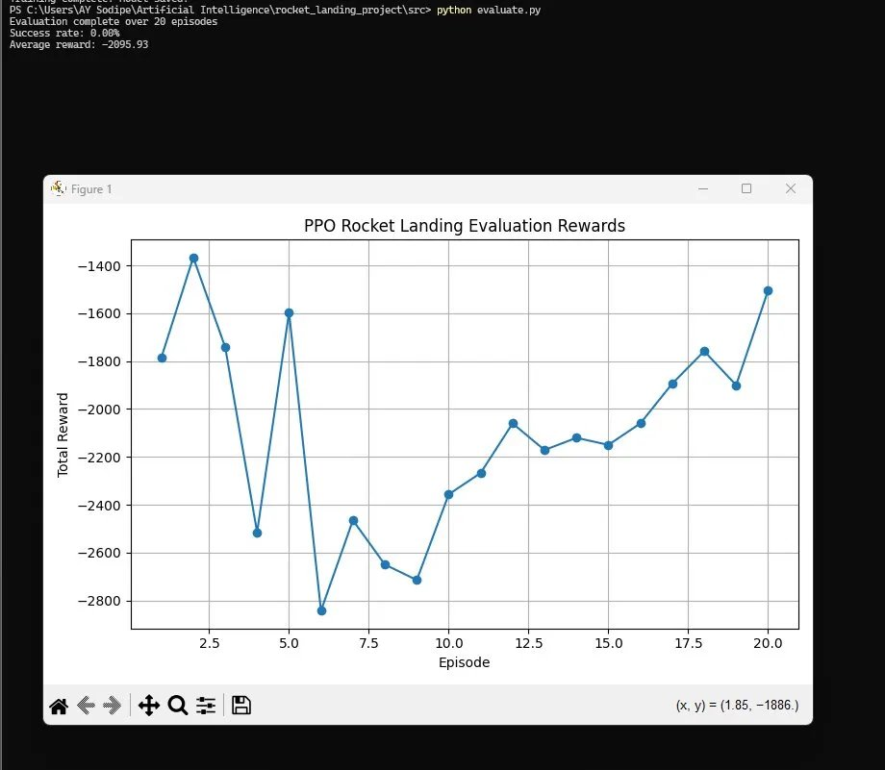
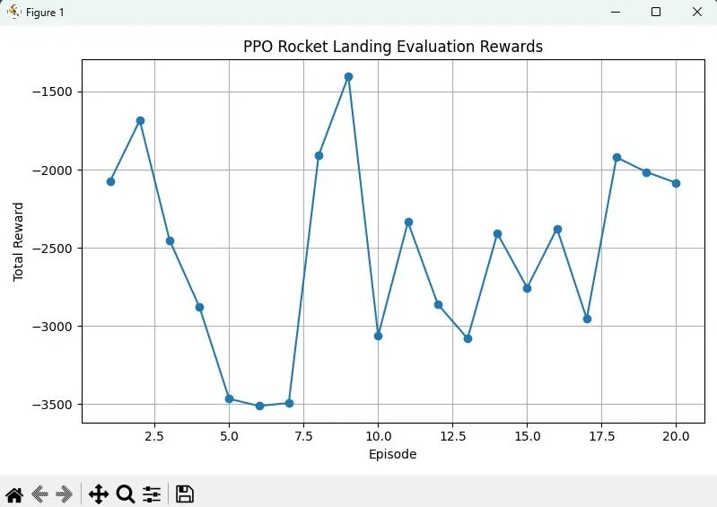
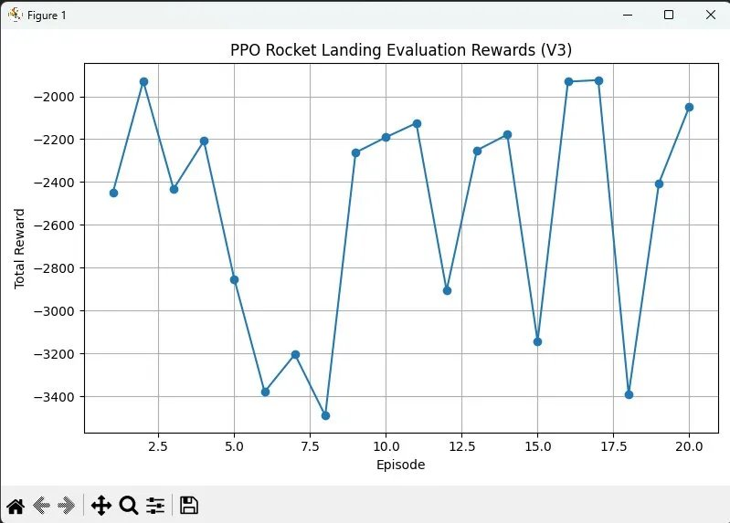
Training Results
Evaluation reward over 20 episodes — all three reward variants
−2095
−2536
−2535
0%
V1 Avg Reward
V2 Avg Reward
V3 Avg Reward
Success Rate (all)
V1 — reward = −dist
V2 — adds |vy| penalty
V3 — full signal
Ayo-Oluwa Sodipe | CSC 4810 — AI | Georgia State University | April 2026

Slide 8
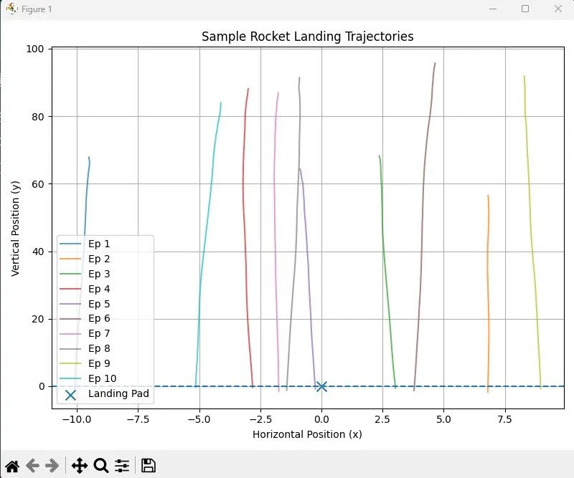
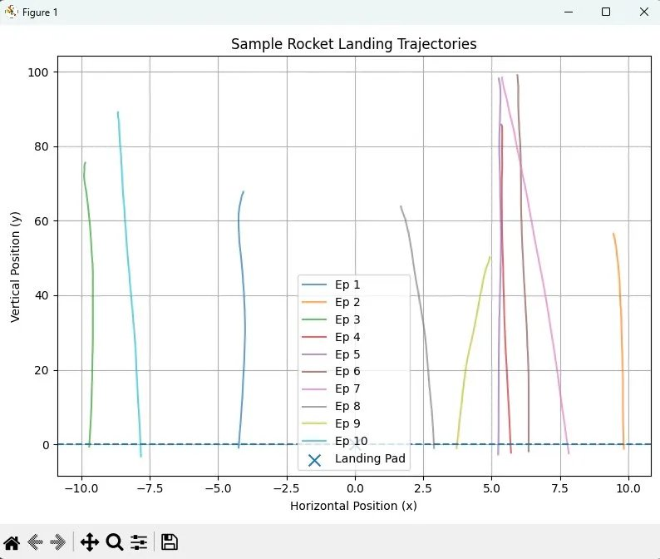
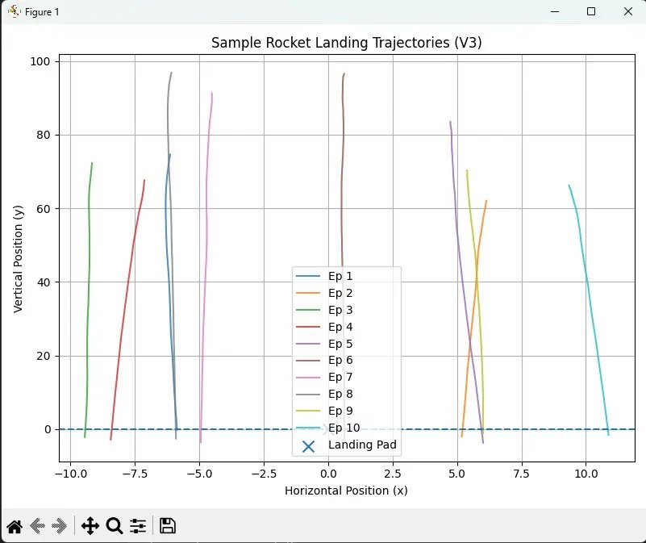
Performance Analysis
Trajectory behavior — all versions fail to converge to landing pad
V1 — Random descent, spreads across x-axis
V2 — Smoother vertical descent, horizontal still scattered
V3 — More structured, but still misses target
V2 reduces reward variance — agent learns to brake vertically — but average reward drops (more timesteps to land)
V3 adds horizontal corrections but reward shows no convergence trend; variance remains high across all 20 episodes
No variant exhibits monotonic improvement; indicating absence of a learnable policy gradient
Ayo-Oluwa Sodipe | CSC 4810 — AI | Georgia State University | April 2026

Slide 9
Core Problem: The Reward Signal Gap
What is fundamentally failing?
This is not a model failure — it is a signal design failure.
The agent receives a dense but non-directional signal — it knows how "bad" a state is, but cannot learn which actions reduce distance effectively.
❌
📉
🔀
No Terminal Reward
Reward Scale vs. Horizon
No Convergence Signal
The reward function penalizes every step equally. There is no positive signal for reaching the landing pad — the agent has no incentive to target (0,0) specifically.
Large negative rewards (−2000 to −3500) accumulated over many steps overwhelm any per-step gradient. PPO's clipped objective cannot distinguish good from bad policies.
Trajectories in V3 are more structured but reward does not trend upward. Additional penalty terms add signal complexity without providing a convergence gradient.
Verdict: Simple dense rewards alone are insufficient for PPO to learn rocket landing; a terminal bonus or curriculum is required for convergence.

Slide 10
Proposed Improvements
Evidence-based next reward engineering steps
01
Terminal Bonus / Sparse Component
02
Shaped Potential-Based Reward
Add a large positive reward (+500) for landing within a success radius. Creates a distinct optimization target — agent has explicit reason to reach (0,0). Directly addresses the missing goal signal.
Potential-based shaping (policy invariant)
φ(s) = −γ⋅dist(s') + dist(s): Theoretically guaranteed to preserve optimal policy while providing richer gradient. No new hyperparameters required beyond discount factor.
03
Curriculum on Initial Conditions
04
Extended Training Budget
Start agent at y₀ ∈ [10, 20] (close to pad), gradually expand to y₀ ∈ [50, 100]. Reduces exploration horizon; agent first learns to land, then to land from height.
Su et al. trained for 400,000 episodes. This project used 100K timesteps. Extending to 500K–1M may allow gradient to emerge even from the current reward.
Priority: Implement terminal bonus (Improvement 01) first; highest expected delta, lowest implementation cost.
Ayo-Oluwa Sodipe | CSC 4810 — AI | Georgia State University | April 2026

Slide 11
Key Findings
What this project reveals about simple reward design for PPO
1
Simple dense rewards change behavior but fail to induce goal-directed convergence; each version produced measurably different trajectory shapes, confirming reward shaping affects agent behavior even without success.
2
Adding velocity penalties (V2, V3) improved structure but hurt average reward; the agent spent more timesteps trying to land slowly, accumulating more negative steps without reaching the pad.
3
No convergence trend was observed in any variant over 20 evaluation episodes; reward plots remain highly variable, indicating the agent did not learn a stable policy.
4
PPO with 100K timesteps is insufficient for this task under simple rewards; consistent with prior work showing that rocket landing requires millions of steps and engineered reward structure.
5
A terminal success bonus is the single most important missing component; without an explicit positive signal for reaching (0,0), gradient descent has no directional anchor.
Core takeaway: Reward function complexity alone does not guarantee policy convergence; structure and signal design must match task difficulty.

Slide 12
Next Steps
Roadmap to a successful landing agent
Phase 1
Phase 2
Phase 3
Immediate
Short-term
Long-term
Add terminal bonus reward (+500 within 0.5 of pad)
Retrain all 3 reward variants with new signal
Compare success rates before/after
Implement curriculum (start close, expand range)
Extend training to 500K–1M timesteps
Log and plot training reward curves (not just evaluation)
Add attitude control (2D orientation)
Introduce wind disturbance for robustness testing
Compare against benchmark: Su et al. multi-stage reward
Goal: Achieve > 50% success rate with terminal bonus (V3+) within the same 100K timestep budget; validating the reward-gap hypothesis identified in this progress report.
This will test whether the failure is due to signal design rather than model capacity.

